Slide 1
pcpfm: A Python-centric pipeline for high-fidelity and high-performance LC-MS metabolomics data processing.
Joshua Mitchell M.D./Ph.D.
Data Scientist
Shuzhao Li Group
The Jackson Laboratory for Genomic Medicine
Notes:
Mention annotation of feature tables. Maybe show example.

Slide 2
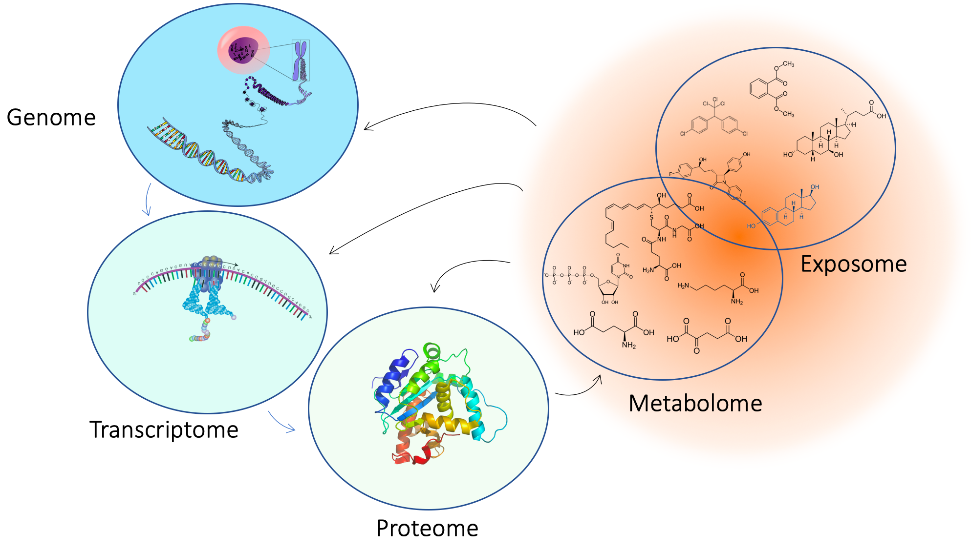
Metabolomics is the comprehensive measurement of biological chemical space
Gene Space
Chemical Space
Notes:
Metabolomics is the comprehensive measurement of biological chemical space. This includes the small molecules present in tissues and cells of organisms, many of which are endogenous metabolites while others are from the environment (i.e., the metabolome and exposome). In this figure, we see where metabolomics and exposomics fits in the central dogma of biology. Genes are expressed to yield transcripts, that are translated to yield proteins which in turn perform the chemical reactions that produce many of the metabolites observed in oru experiments. These metabolites also greatly impact the activity of the genome, transcriptome, and proteome.

Slide 3
Metabolomics is the comprehensive measurement of biological chemical space
Gene Space
Chemical Space
SEQUENCING
MASS SPECTROMETRY
Notes:
Another notable distinction is the technologies used for studying these entities. On the left, sequencing of one form or another is used to analyze these samples. Chemical space on the other hand is measured primarily using mass spectrometry-based techniques.

Slide 4
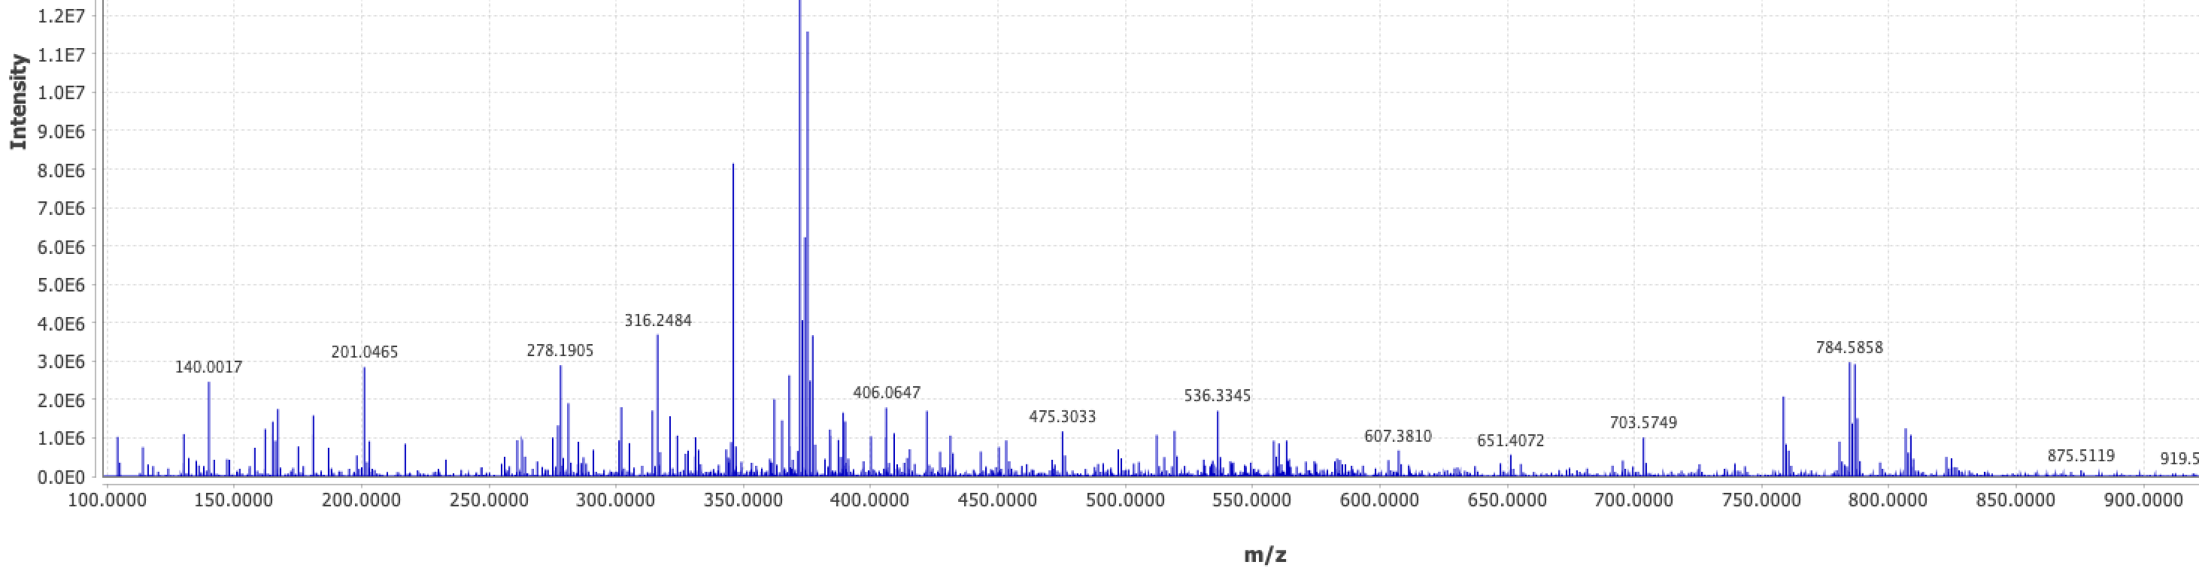
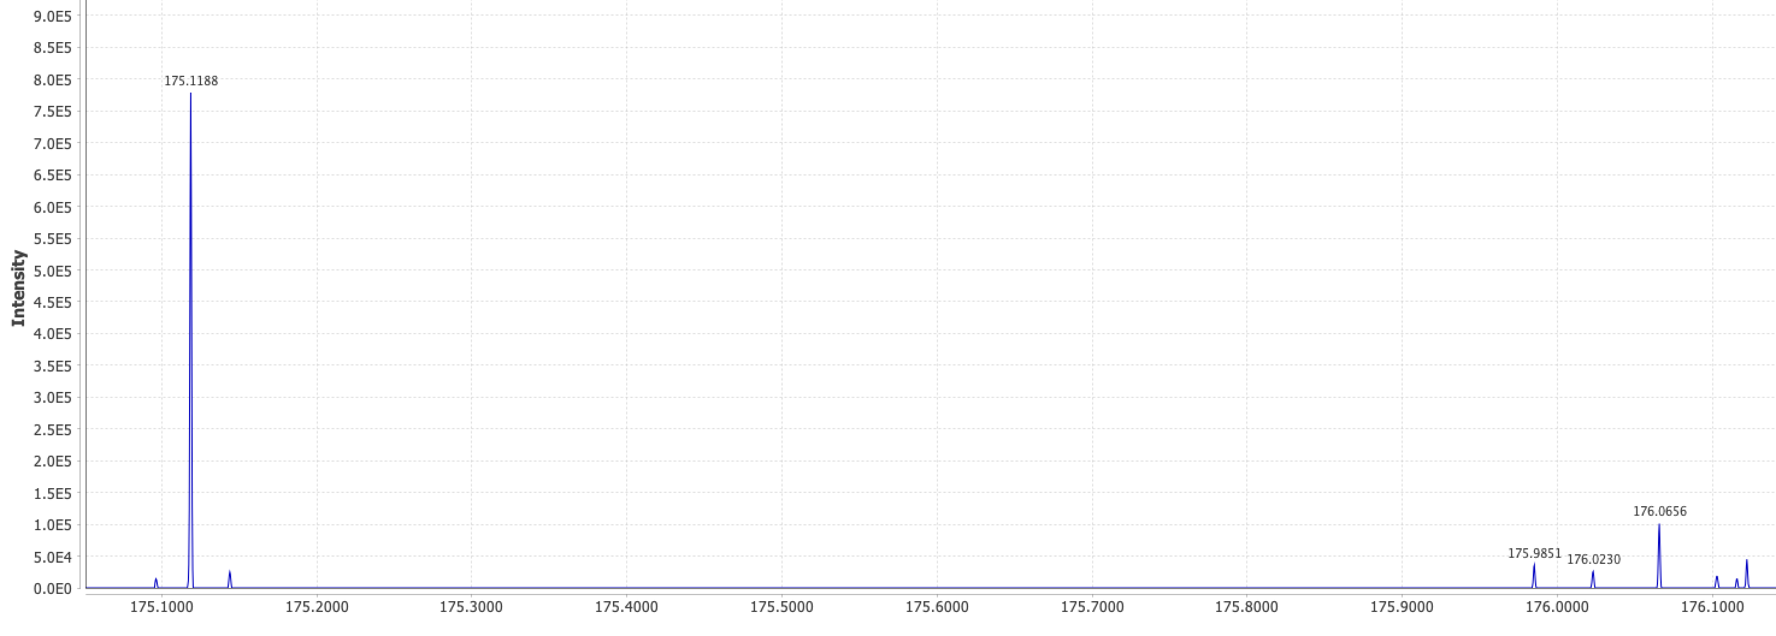
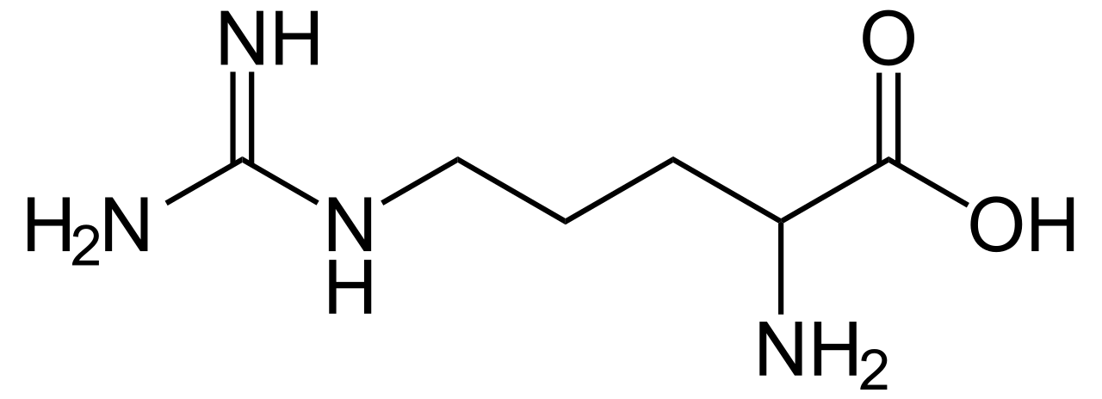
Advantages and challenges of Mass Spectrometry
A single mass spectrum (i.e., scan) of a complex mixture is a lot of data.
m, [+H⁺]
Arginine
Each scan is a composition of spectra for many compounds, including different adducted forms, isotopologues, etc.
C₆H₁₄N₄O₂
175.1188 ≈ 174.1114 + 1.0078
m+¹³C₁, [+H⁺]
Notes:
Another notable distinction is the technologies used for studying these entities. On the left, sequencing of one form or another is used to analyze these samples. Chemical space on the other hand is measured primarily using mass spectrometry-based techniques.

Slide 5
Advantages and challenges of Mass Spectrometry
Chromatographic Retention Time
Additionally, most experiments couple chromatography to mass spectrometry meaning multiple spectra for each sample. Data becomes complex quickly.
Notes:
Another notable distinction is the technologies used for studying these entities. On the left, sequencing of one form or another is used to analyze these samples. Chemical space on the other hand is measured primarily using mass spectrometry-based techniques.

Slide 6
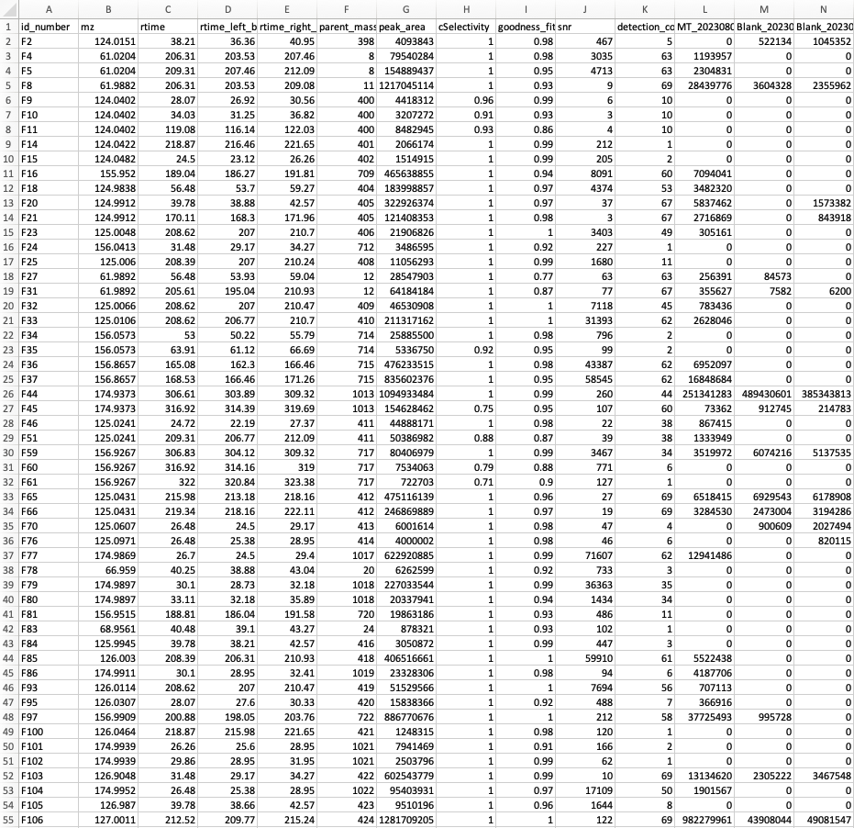
LC-MS Pre-Processing
Sample 1
Sample 2
Feature Table
Pre-Processing
Sample 3
Sample 4
…
Goals:
Identify regions of interest in acquisitions (feature)
Provide an estimate of that feature’s abundance per sample
Existing tools are:
Computationally expensive
Produce inconsistent features
Poorly align retention time and mass across samples
Notes:
Another notable distinction is the technologies used for studying these entities. On the left, sequencing of one form or another is used to analyze these samples. Chemical space on the other hand is measured primarily using mass spectrometry-based techniques.

Slide 7
Reproducibility issues in LC-MS metabolomics data processing
XCMS 10,901
features
MZmine
42,099 features
6,186
Li et al., (2023) Nature Communications, 14(1), 4113.
Myers et al. (2017). Analytical Chemistry, 89(17): 8689
Delabriere et al., (2021). Analytical Chemistry, 93(45):15024
Notes:
Another notable distinction is the technologies used for studying these entities. On the left, sequencing of one form or another is used to analyze these samples. Chemical space on the other hand is measured primarily using mass spectrometry-based techniques.

Slide 8
Top Four Reasons for Poor Reproducibility
High rate of correspondence errors in large data
Spurious number of low-quality peaks, confusion of sensitivity
Peak detection not transparent enough
Too many parameters, too dependent on local expertise
Notes:
Another notable distinction is the technologies used for studying these entities. On the left, sequencing of one form or another is used to analyze these samples. Chemical space on the other hand is measured primarily using mass spectrometry-based techniques.

Slide 9
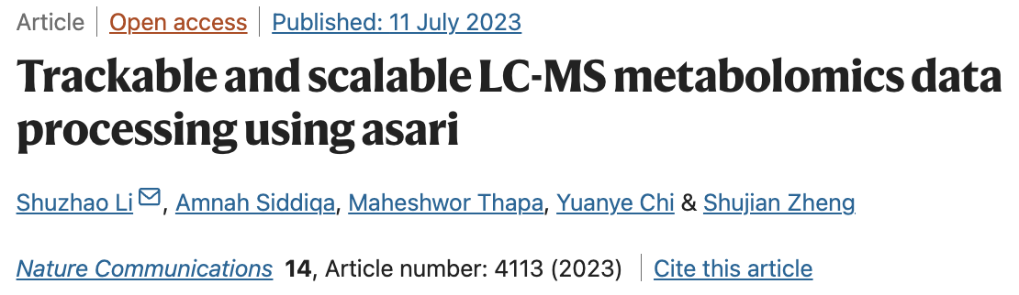
Detailed account of technical issues
Trackable data structure at every level in asari
New algorithms, new build
A useful set of quality control metrics
Performant, easy to deploy, easy to scale

Slide 10
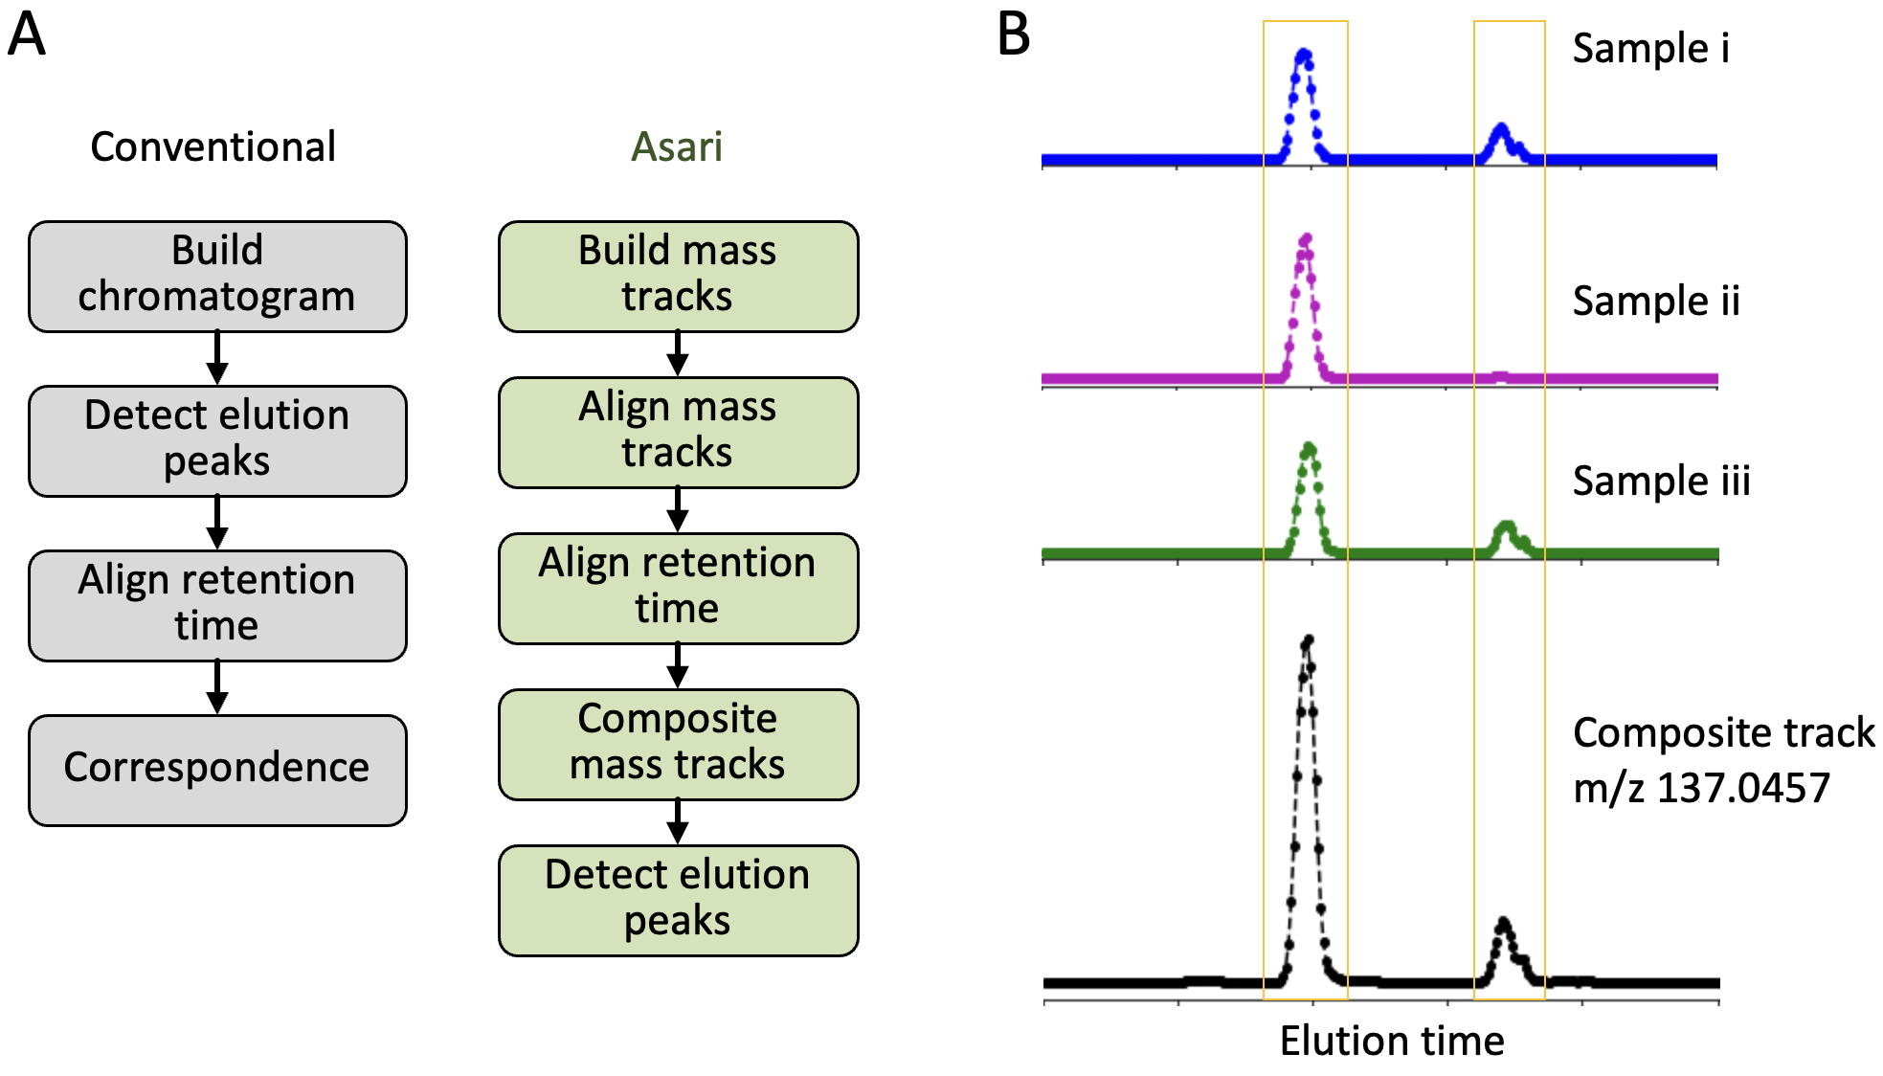
Asari vs. Conventional

Slide 11
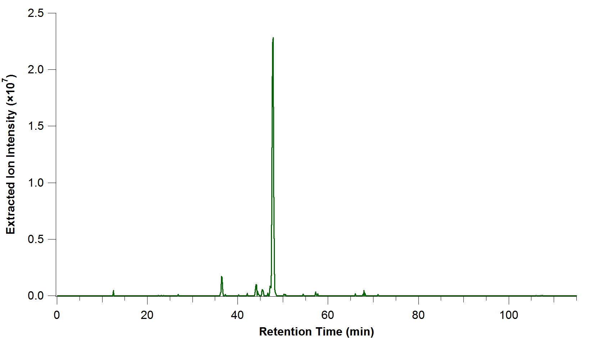
Asari vs. Conventional
Peak Detect
rt
m/z
By CWenger at English Wikipedia, CC BY-SA 3.0, https://commons.wikimedia.org/w/index.php?curid=70844603

Slide 12
Asari vs. Conventional
Alignment
Peak Detect
rt
rt
m/z
m/z
By CWenger at English Wikipedia, CC BY-SA 3.0, https://commons.wikimedia.org/w/index.php?curid=70844603

Slide 13
Asari vs. Conventional
Alignment
rt
Peak Detect
rt
m/z
rt
m/z
m/z
By CWenger at English Wikipedia, CC BY-SA 3.0, https://commons.wikimedia.org/w/index.php?curid=70844603

Slide 14
Asari vs. Conventional
Replace w/ XIC
Alignment
rt
Peak Detect
rt
m/z
rt
m/z
rt
m/z
Failed correspondence
m/z
Peak picking then alignment makes alignment more difficult (2d alignment).
Fails to fully leverage the high m/z resolution of modern LC-MS instruments
By CWenger at English Wikipedia, CC BY-SA 3.0, https://commons.wikimedia.org/w/index.php?curid=70844603

Slide 15
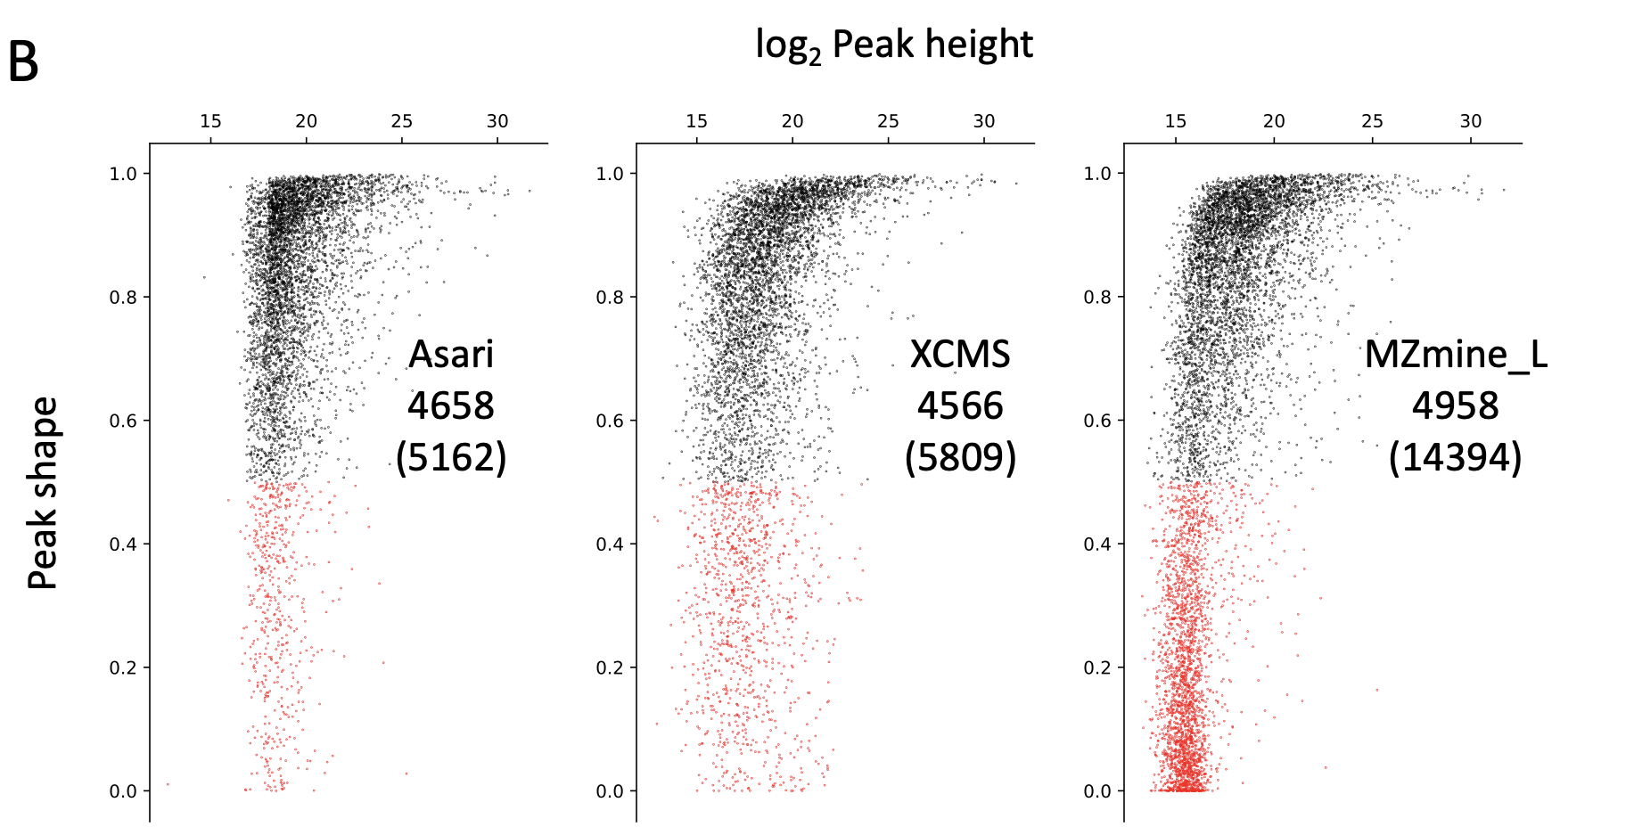
Many Low-Quality Peaks Due to Low Mass Selectivity
Log Peak Height
Goodness of Peak Shape
Many features but many are low quality.

Slide 16
Many Low-Quality Peaks Due to Low Mass Selectivity
MZmine
Log Peak Height
XCMS
m/z | rtime | m/z | rtime
760.5857 | 73 | 760.5807 | 68
760.5833 | 73 | 760.5817 | 72
760.5815 | 67 | 760.5826 | 72
 |  | 760.5837 | 72
 |  | 760.5847 | 73
Falsely resolved isobaric features due to poor mass alignment
Goodness of Peak Shape
XCMS
MZmine
Asari
Kernel Density
Many features but many are low quality.
Mass Selectivity

Slide 17
Asari Leverages High Resolution Mass to Improve Data Quality

Slide 18
Asari Leverages High Resolution Mass to Improve Data Quality
Mass tracks are XICs spanning all retention time

Slide 19
Asari Leverages High Resolution Mass to Improve Data Quality
Mass tracks are XICs spanning all retention time

Slide 20
Asari Leverages High Resolution Mass to Improve Data Quality
Mass tracks are XICs spanning all retention time
Notes:
Errors in mass alignment not sole reason for poor performance.

Slide 21
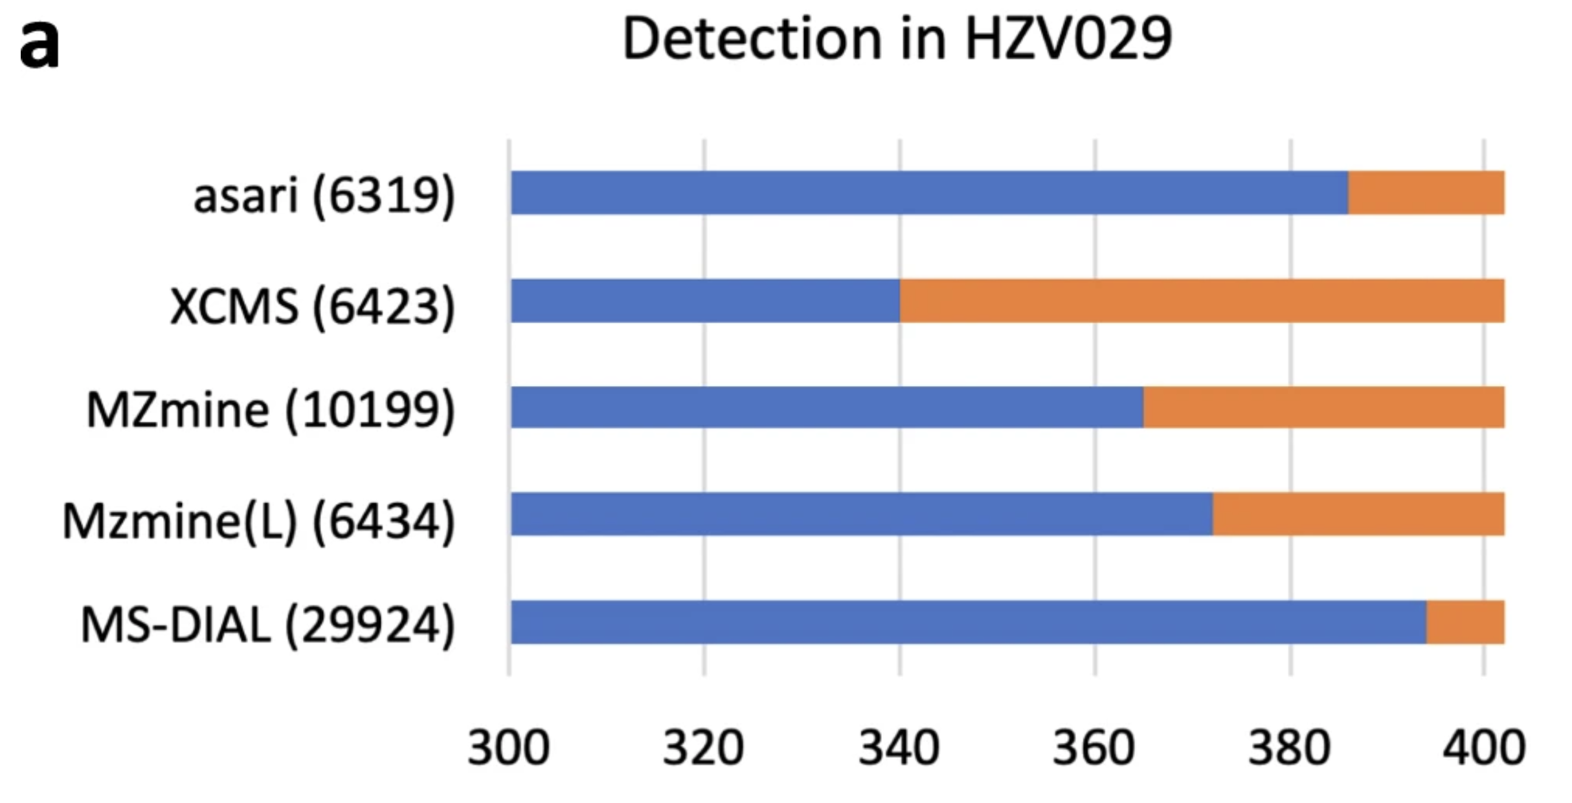
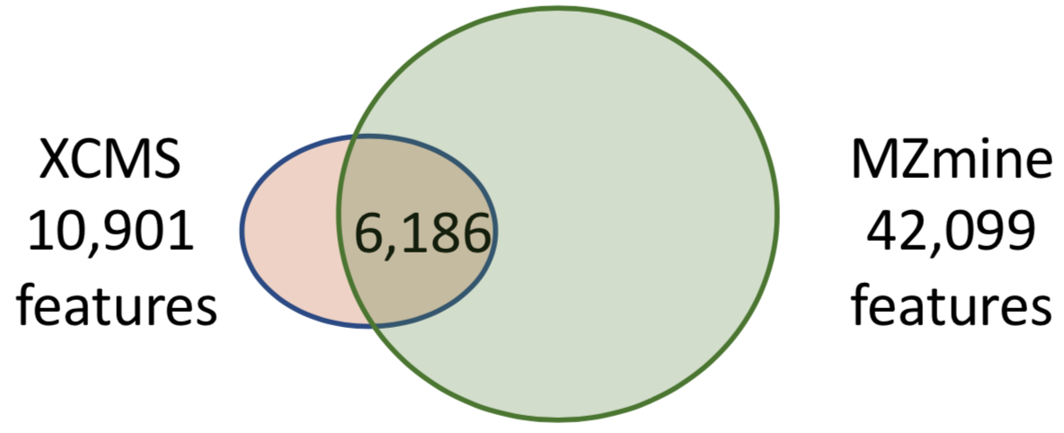
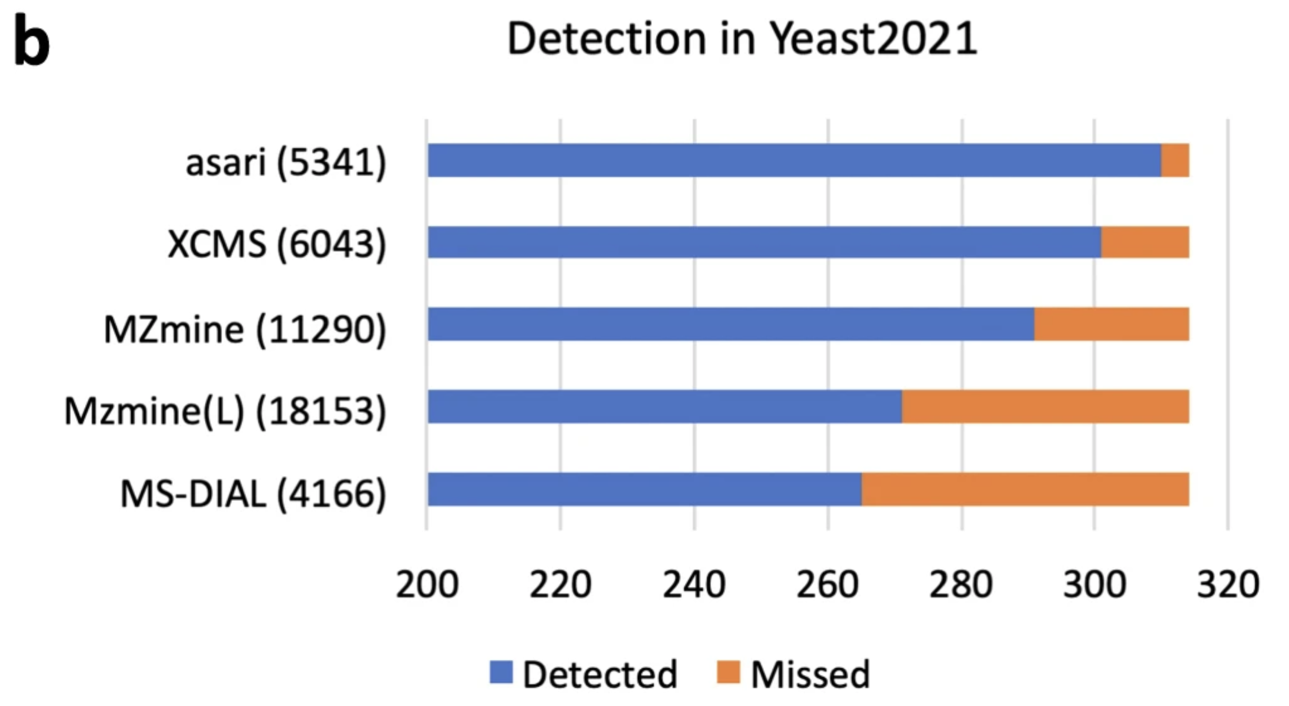
Why Asari?
Features from 184 Pooled QC Samples
Poor Consistency with Multiple Datasets
Asari Reference Here
Why discrepancies, thats why we introduce the qc metric. Mechanism implies high quality features, reproducible. Asari-X is higher “sensitivity”.

Slide 22
Asari Improves Feature Quality and Computational Performance
Log Peak Height
Goodness of Peak Shape
Fewer features, but consistent.

Slide 23
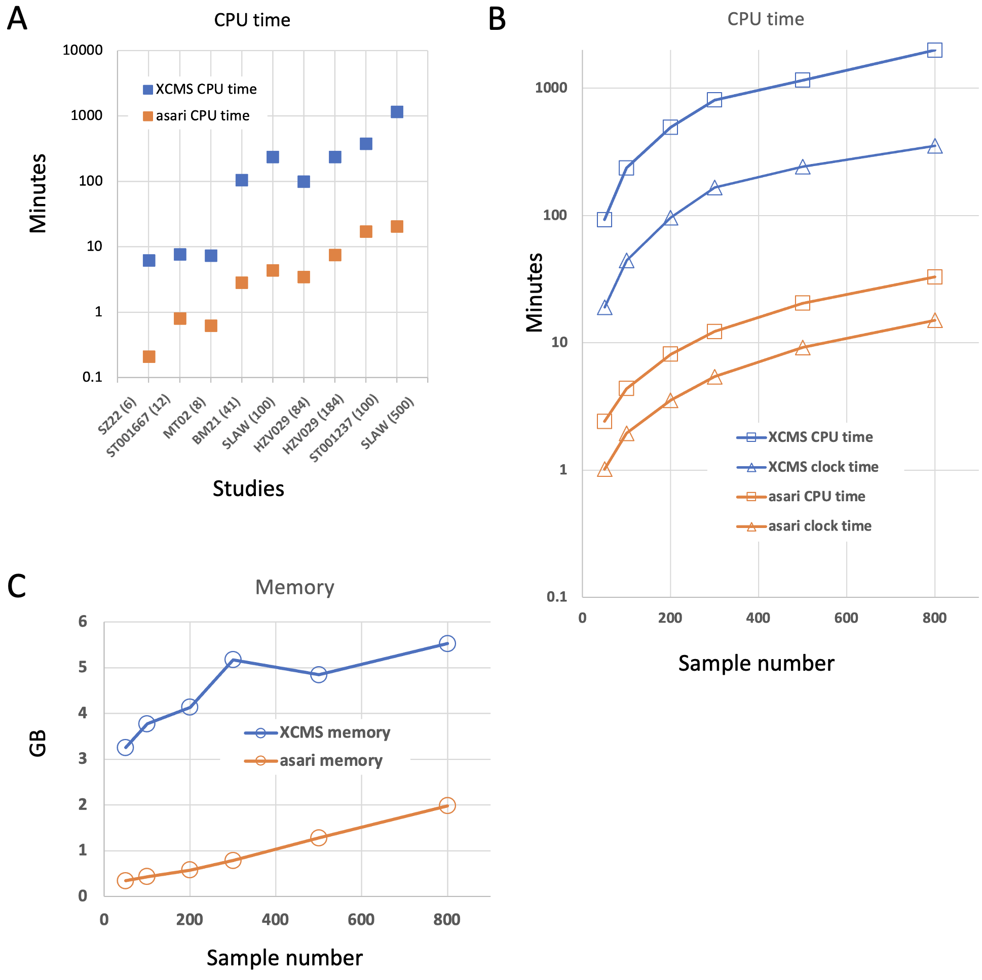
Asari Improves Feature Quality and Computational Performance
Log Peak Height
Goodness of Peak Shape
Fewer features, but consistent.
Order of magnitude improvement in runtime
These are features from asari but poor gof due to padding for comparison to other tools

Slide 24
Beyond Feature Tables
Quality Control
Annotation
Reporting
Notes:
More details: spikein, PCA, correlation, etc. (can be talking points)

Slide 25
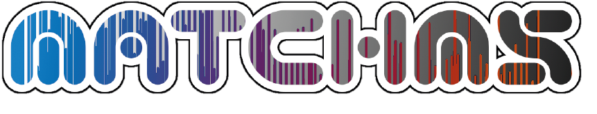
Annotation
khipu pre-annotation for both regular and isotope tracing data. Yields empirical compounds.
JSON centric, chaining MS, MS/MS and authentic libraries
Li and Zheng, 2023. Analytical Chemistry
MS/MS search by MatchMS, accelerated with IntervalTrees
Matchms – processing and similarity evaluation of mass spectrometry data. (2020) Journal of Open Source Software, 5(52), 2411. https://doi.org/10.21105/joss.02411

Slide 26
What is an empirical compound?
Traditional techniques, each feature is queried for annotation = 6 searches! More false positives
One Compound, Many Features
m, +H⁺
m, +Na⁺
m+¹³C₁, +H⁺
m, +ACN⁺
m+¹³C₂, +H⁺
m+¹³C₁, +Na⁺
m/z
Empirical Compound
Empirical compound means one query and fewer false positives.
Inferred Neutral Mass
mzunit, CAMERA, binner perform a similar ‘pre-annotation’ but khipu performs the regression that allows for the inference of mass and yields a computable data structure.
Difference is that khipu is computable / empcpd is data structure. Downstream software.
vs. mzunit, CAMERA, binner (Michigan)
Regression through grid allows better inferred mass
Maybe show grid?
Collapse with prev. slide

Slide 27
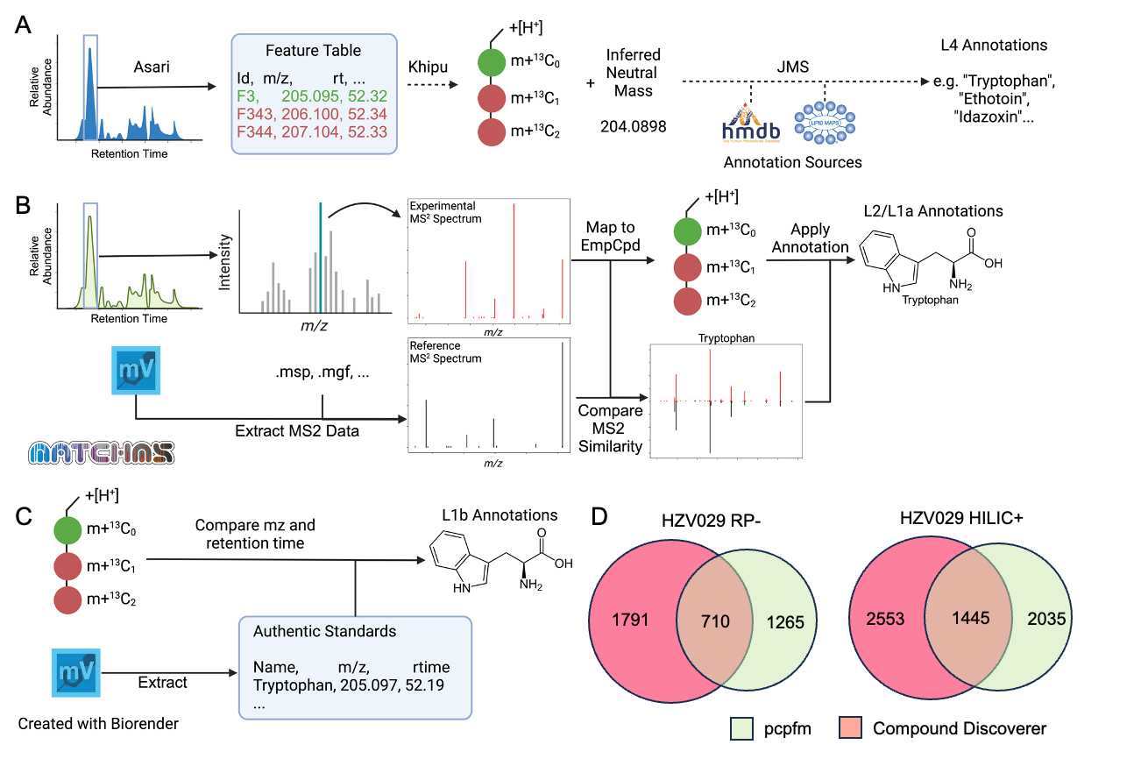
Annotation Levels

Slide 28
Annotation Levels

Slide 29
Annotation Levels

Slide 30
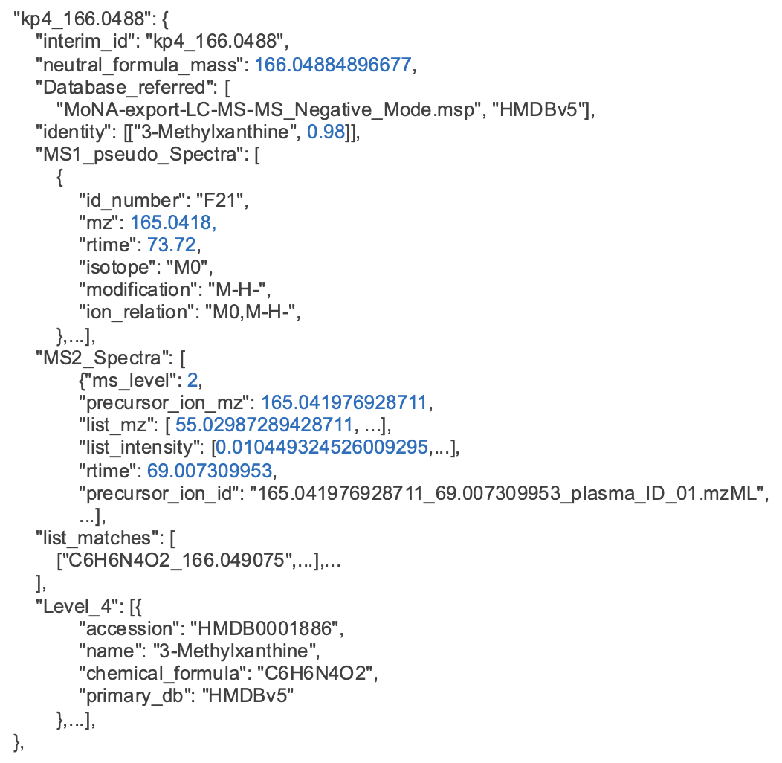
JSON Example of Chained Annotation
Made possible using empirical compounds
Notes:
Not searching all features against all entries.
Schmansky

Slide 31
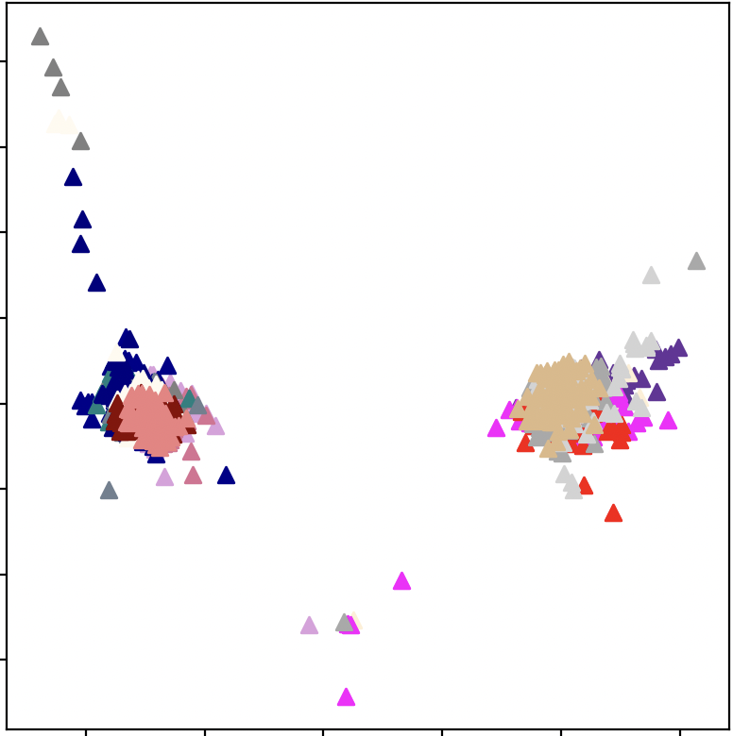
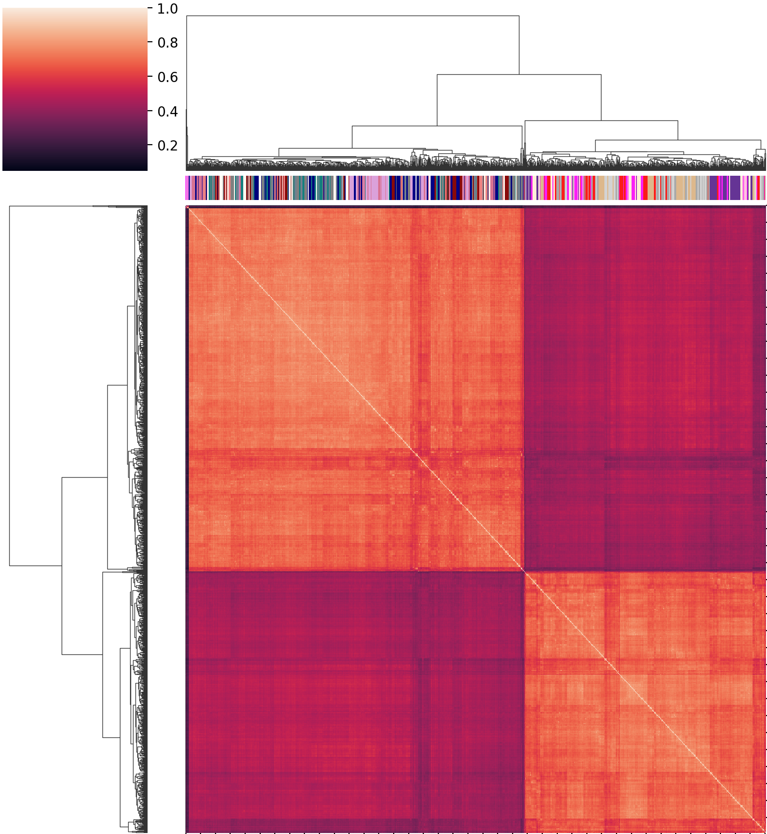
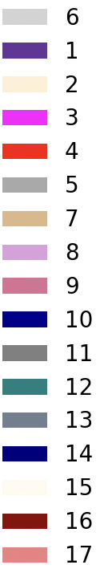
Large Experiment QA/QC Example
Batch 1
Batch 2
Batch 3
Batch 4
Batch 5
Batch 6 Batch 7
Batch 8
Batch 9
Batch 10
Batch 11
Batch 12
Batch 13
Batch 14
Batch 15
Batch 16
Batch 17
PC2 - 2.1%
Calibration
Group 1
Group 2
PC1 – 6.4%
~1700 samples over 17 batches
Raw Data
Notes:
Batch on top, not repeat.,

Slide 32
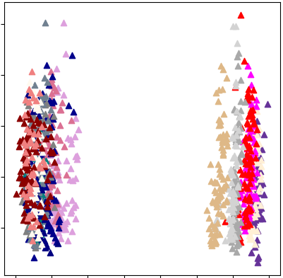
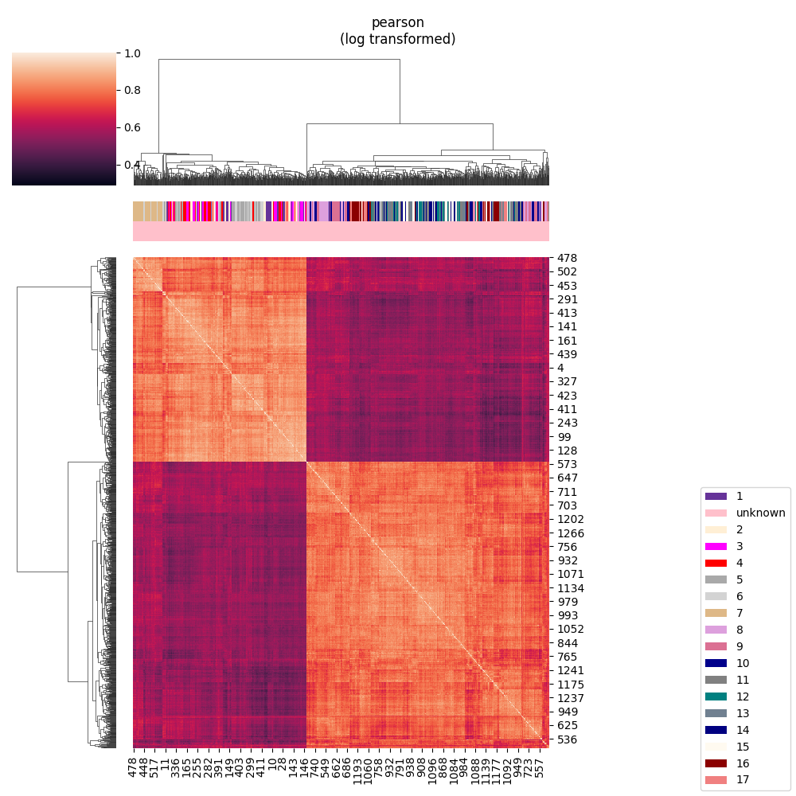
Large Experiment QA/QC Example
Batch 1
Batch 2
Batch 3
Batch 4
Batch 5
Batch 6 Batch 7
Batch 8
Batch 9
Batch 10
Batch 11
Batch 12
Batch 13
Batch 14
Batch 15
Batch 16
Batch 17
Calibration
PC2 – 10.8%
Calibration
PC1 – 6.4%
PC2 – 28.5%
Normalized, Interpolated

Slide 33
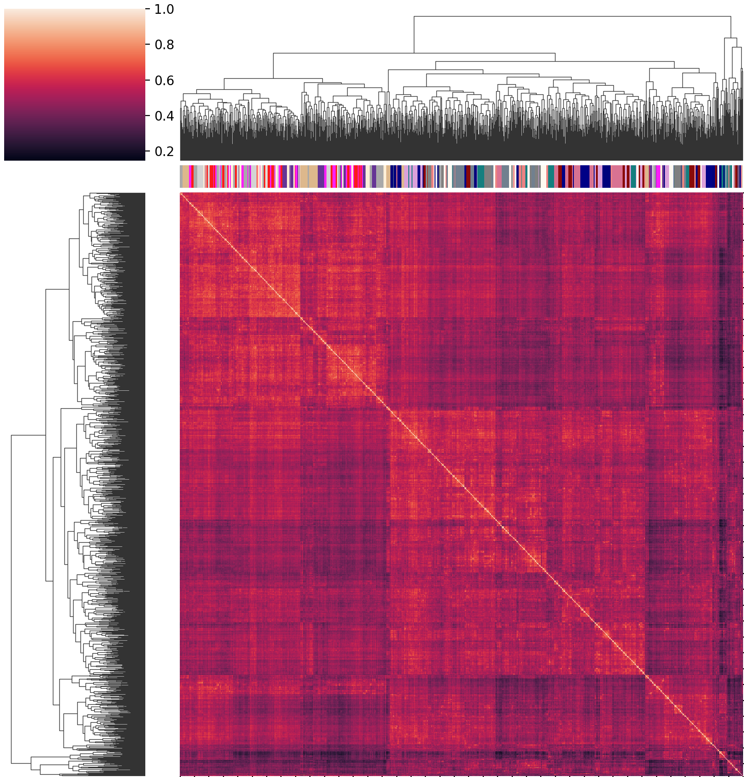
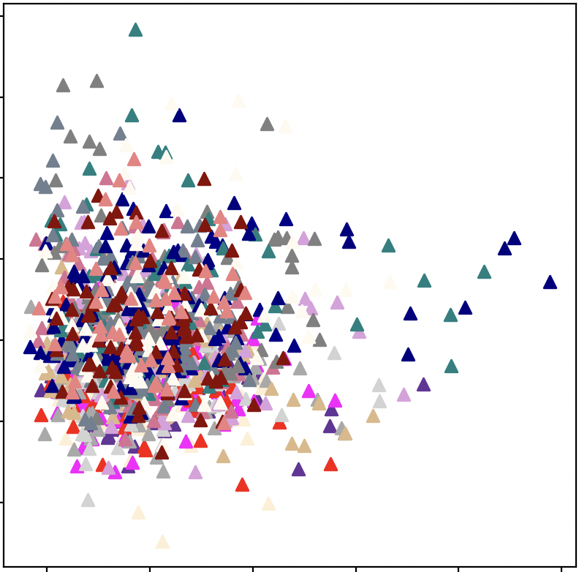
Large Experiment QA/QC Example
Batch 1
Batch 2
Batch 3
Batch 4
Batch 5
Batch 6 Batch 7
Batch 8
Batch 9
Batch 10
Batch 11
Batch 12
Batch 13
Batch 14
Batch 15
Batch 16
Batch 17
Calibration
Calibration
PC2 – 3.1%
PC1 – 9.8%
Batch Corrected

Slide 34
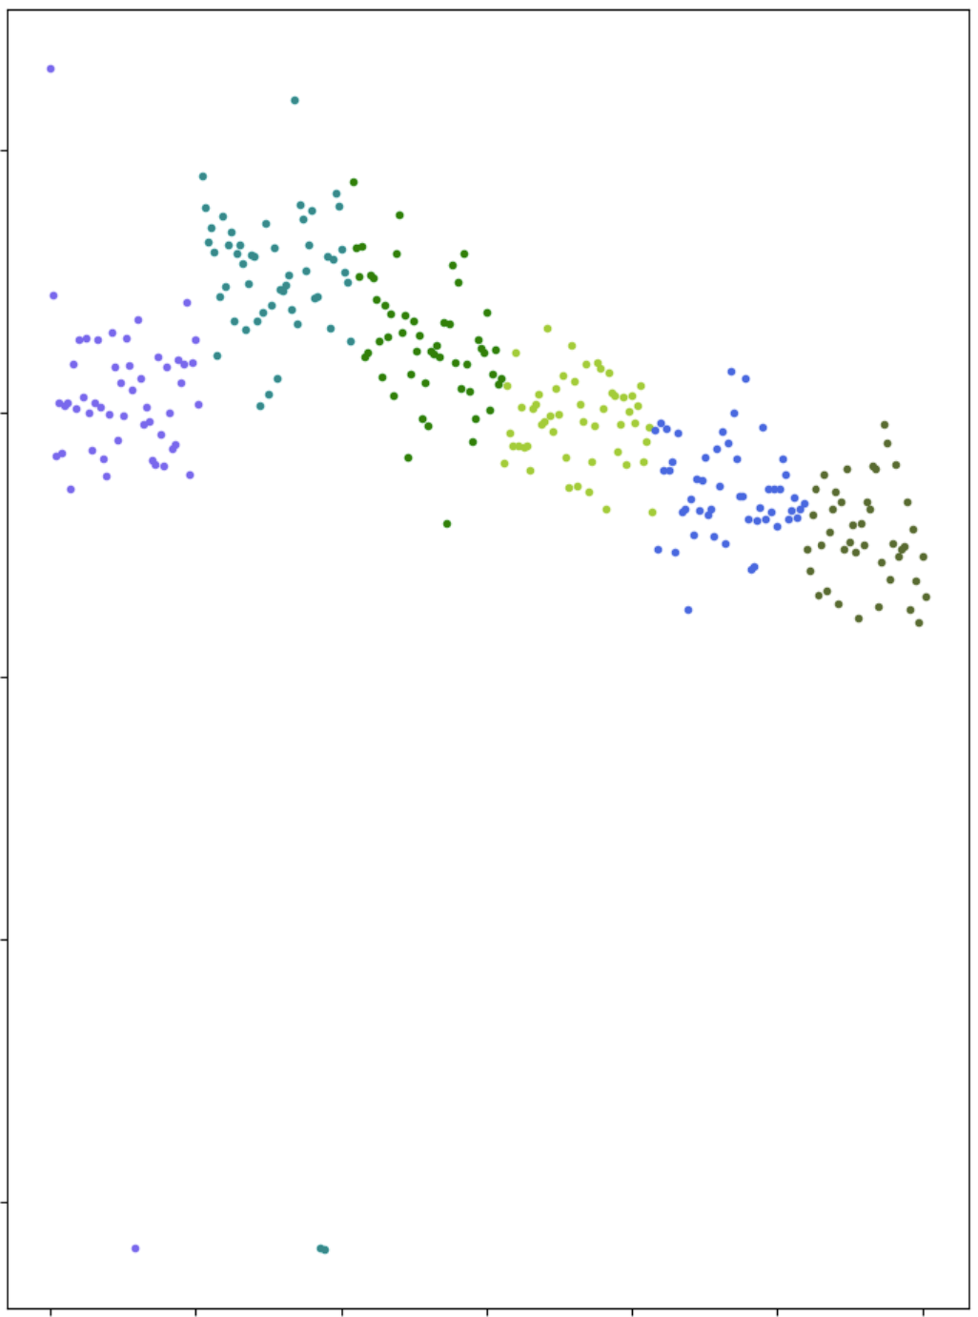
Outlier and Annotation Example Results
HZV029 RP-
HZV029 HILIC+
2
1791
710
1265
2553
1445
2035
# Features Z-Score
0
pcpfm
Compound Discoverer
High MS² annotation similarity between CD and pcpfm
-6
Failed Injections
Sample Number

Slide 35
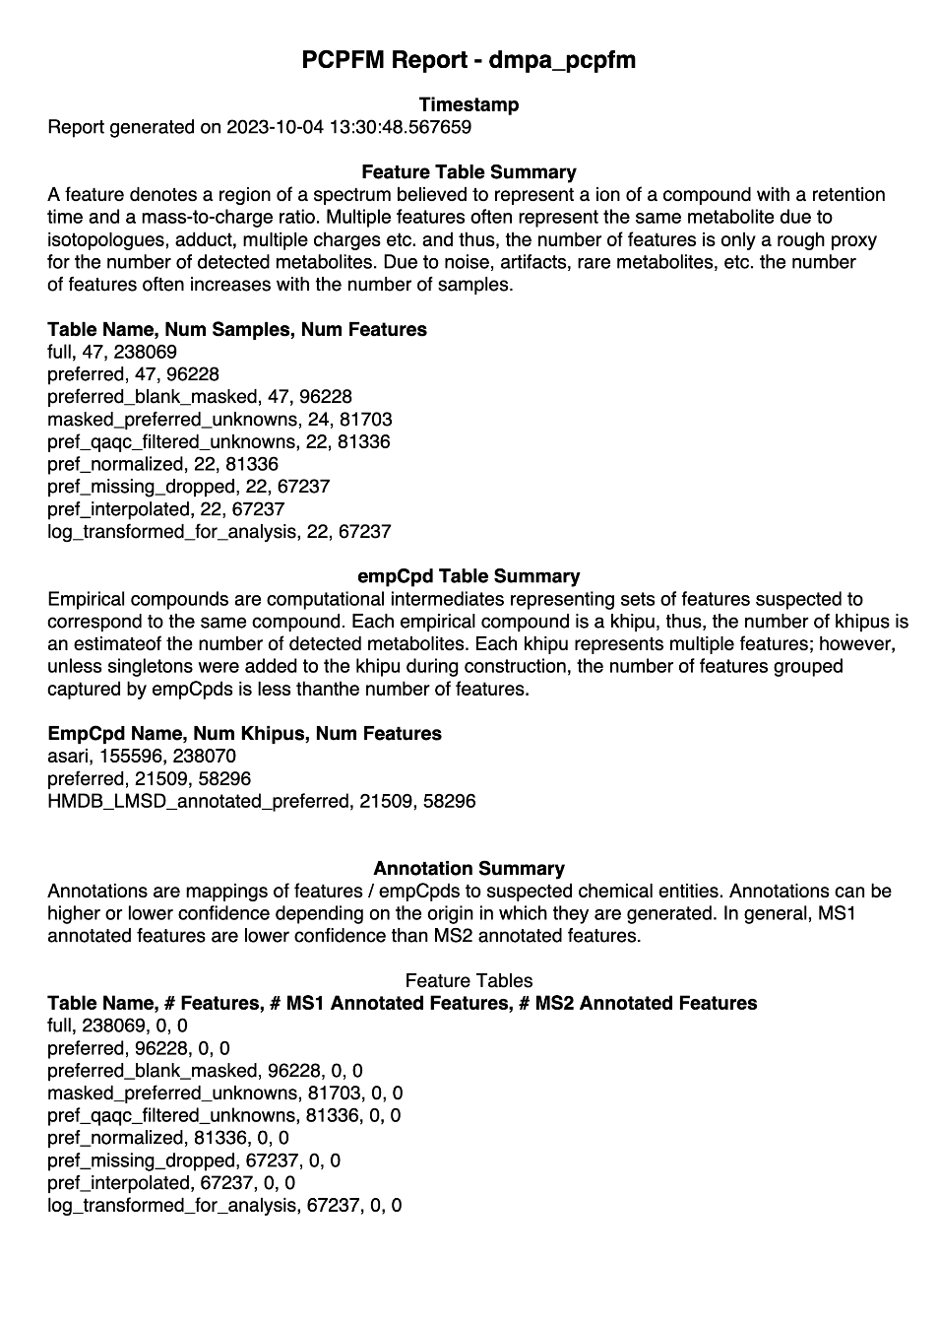
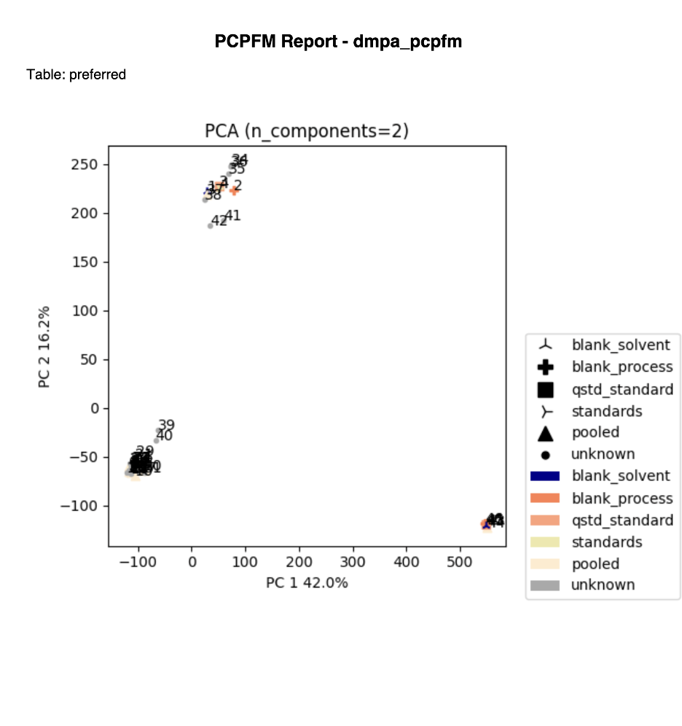
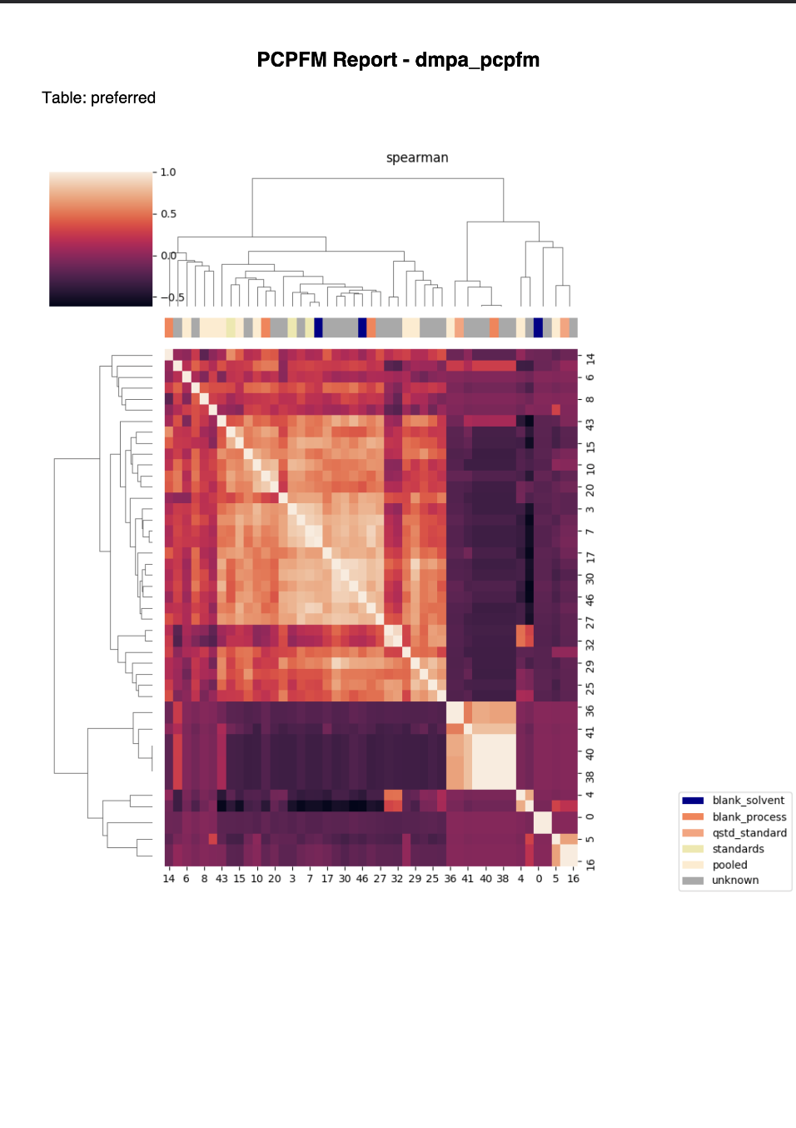
Example Reports

Slide 36
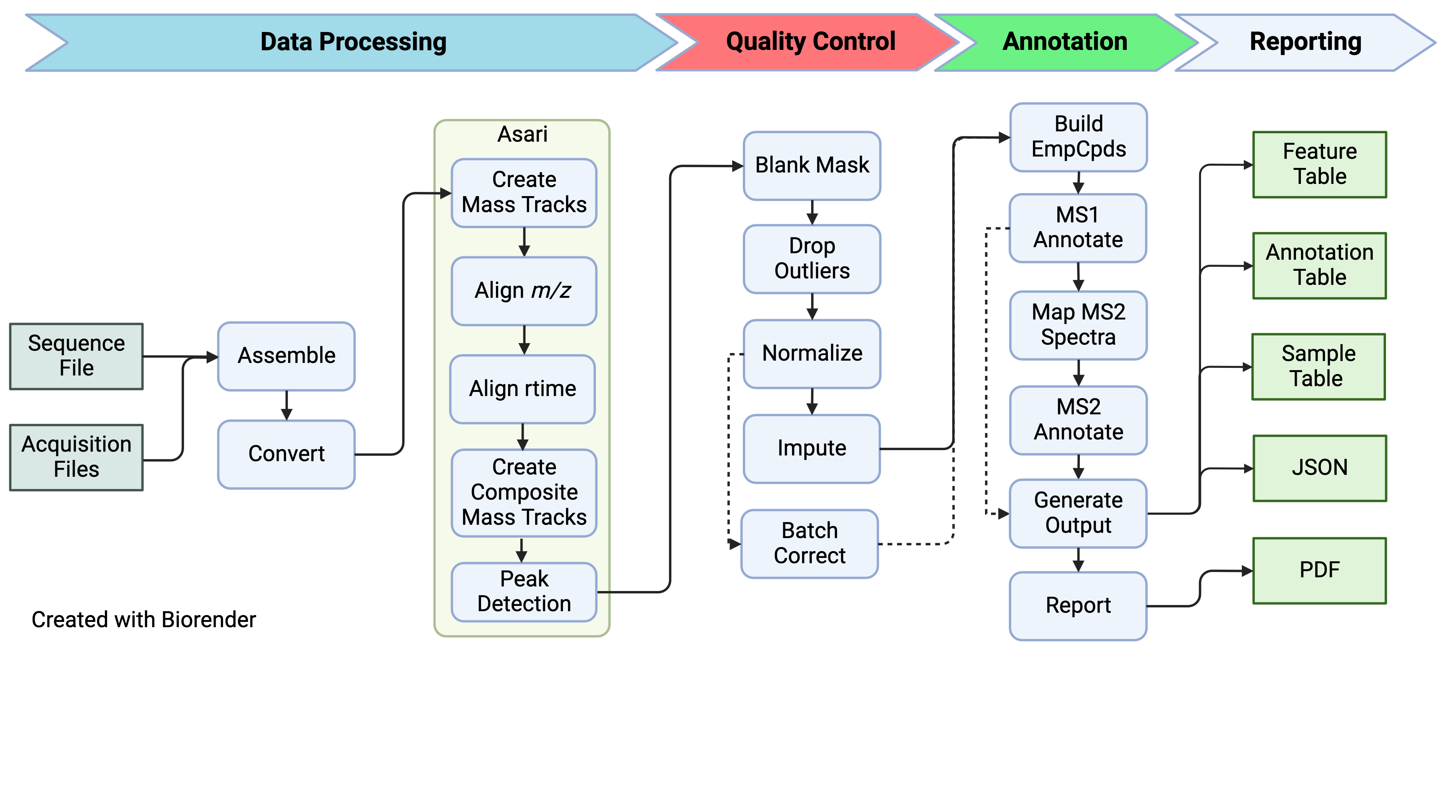
Example Workflow

Slide 37
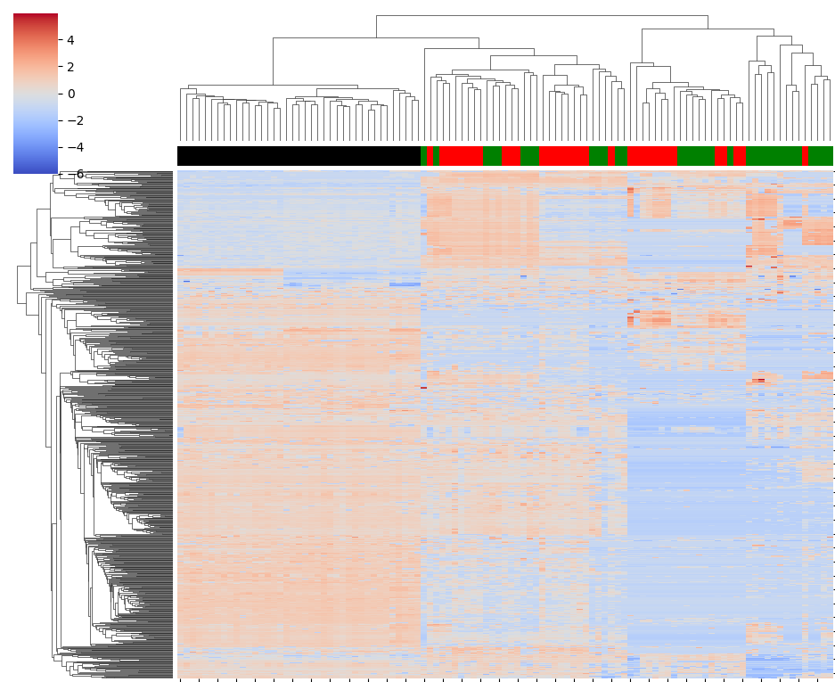
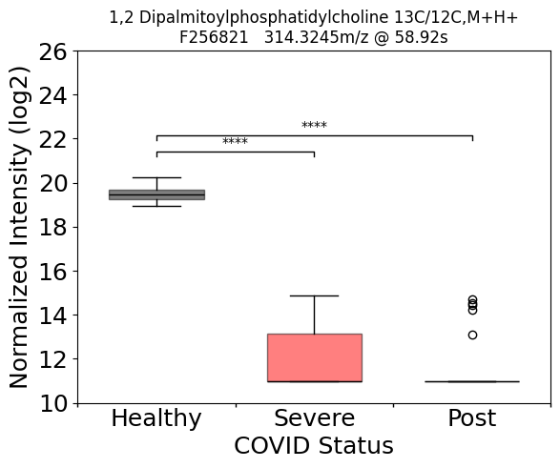
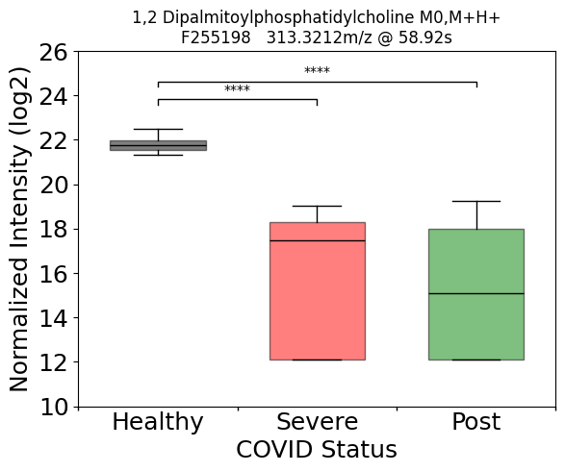
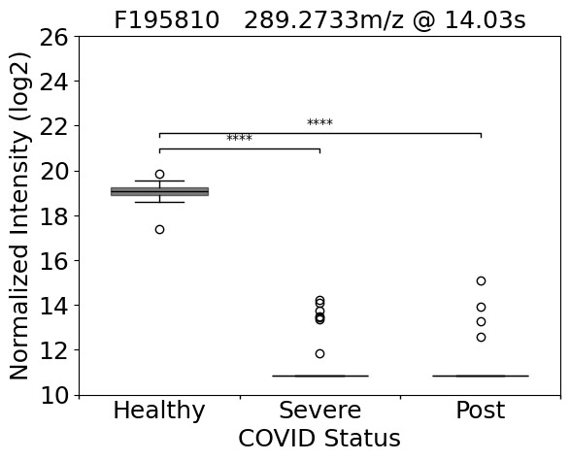
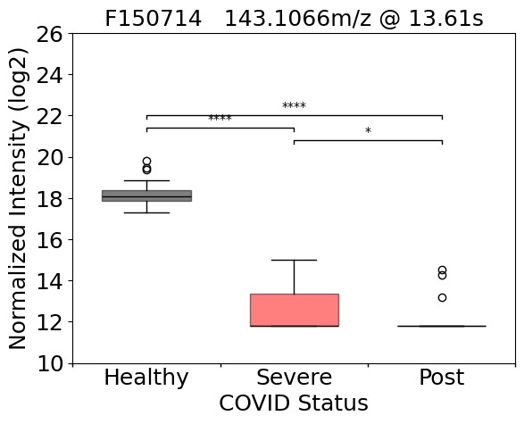
Example pcpfm Results
Ansone 2021 re-analysis
1,2-DPPC [H+, m+¹³C₁]
F210226
314.3245m/z @ 58.78
1,2-DPPC [H+, m]
F209589
313.3212m/z @ 58.92s
4
0
26
Z-Score
26
-4
-4
22
22
18
18
14
14
10
10
HC
SC19
HC
PC19
SC19
PC19
Normalized Log2 Abundances
F150714
143.1066m/z @ 13.61s
F195810
289.2733m/z @ 14.03s
26
26
22
22
18
18
Significant Features (p_{corr} < .05)
14
14
10
10
HC
SC19
PC19
HC
SC19
Healthy Control (HC)
Severe COVID-19 (SC19)
Post COVID-19 (PC19)
COVID Status
PC19
* p_{corr} <.05
** p_{corr} <.01
*** p_{corr} <.001
**** p_{corr} <.0001
Pcpfm recapitulates the clustering of patients from the original manuscript
But produces different annotations.

Slide 38
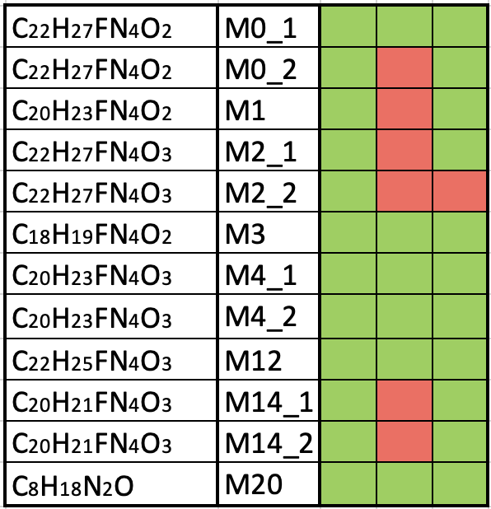
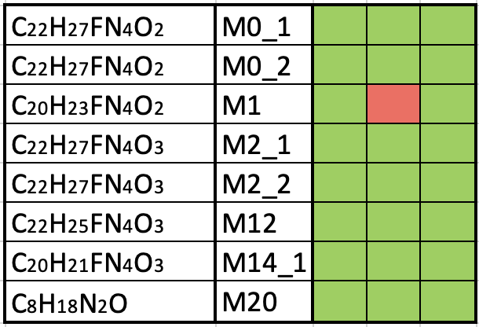
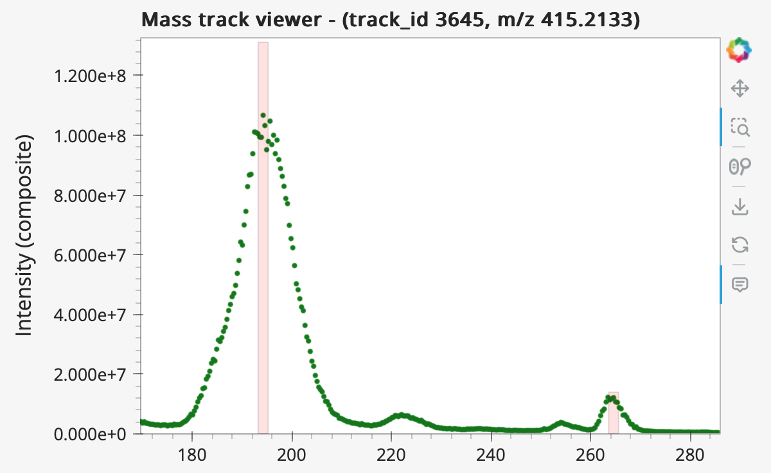
Example pcpfm Results
Bowen 2023 re-analysis
Full
Preferred
Bowen
Full
Preferred
Formula
ID
Bowen
Cell Pellet
x10⁸
Formula
ID
Cell Pellet, m/z = 415.2133
Media
1.2
Not Detected
1.0
Detected
0.8
Composite Mass Track
Intensity (absolute)
0.6
0.4
M2_2
0.2
0
280
260
200
240
Not Detected
180
220
Detected
Pcpfm finds most features without a specialized workflow
Trivial inspection of missing features

Slide 39
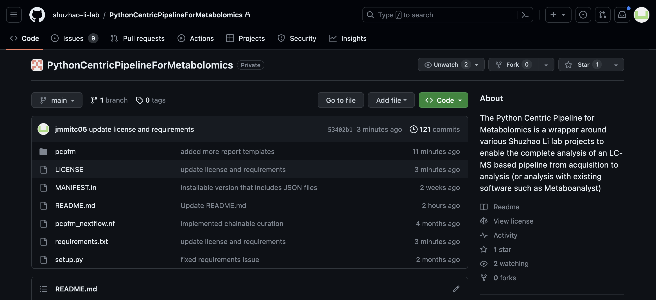
Open Source Matters
Both Asari and pipeline are open-source
Reuse welcome
Feel free to submit issues and request features

Slide 40
Conclusions
Still looking for feedback, evolving but stable enough.
Data analysis notebooks in the repository.
https://github.com/shuzhao-li-lab/PythonCentricPipelineForMetabolomics
Link to other tutorials and examples.
https://github.com/shuzhao-li-lab/pcpfm_tutorials (work in progress)
Data repo for datasets
https://github.com/shuzhao-li-lab/data/
Contact me at: joshua.mitchell@jax.org
Notes:
Will push new version to pypi with new name before conference.

Slide 41
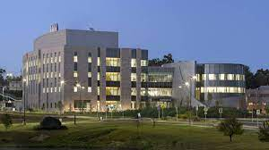
Acknowledgements
Shuzhao Li Group
Shuzhao Li
Yuanye Chi
Shujian Cheng
Maheshwor Thapa
Minghao Gong
Amnah Siddiqa (Former)
Other JAX Collaborators
Robson Lab
Juliana Alcoforado Diniz
Zukai Liu
Arti Taggar
Dylan Baker
Anahita Amiri
Non-Jax Collaborators
Stephen Barnes
Jianguo (Jeff) Xia
Lei Xu
The Jackson Laboratory for Genomic Medicine
Farmington, CT
Funding
UM1HG012651
RO1AI149746
U01CA235493

Slide 42
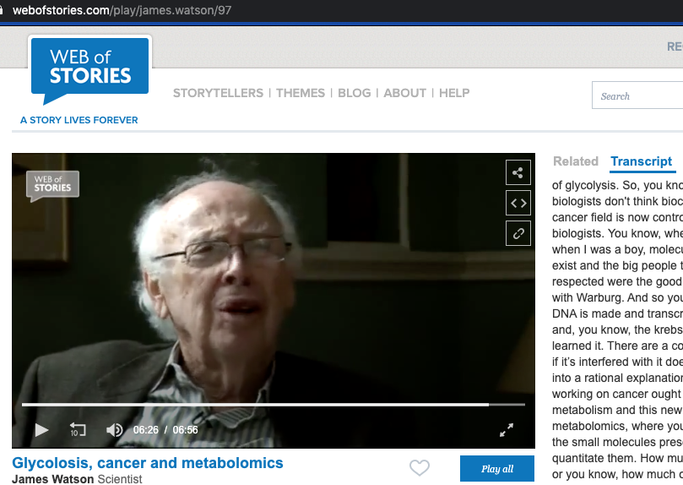
A comment on Metabolomics from 2009
So, you know, the molecular biologists don't think biochemistry. And so the cancer field is now controlled by molecular biologists. You know, whereas, you know, when I was a boy, molecular biologists didn't exist and the big people that everyone respected were the good biochemists, starting with Warburg.
So you know, if I were, you know, doing a PhD, I'd do it metabolomics, you know, if you wanted to be a biochemist because you're likely to get a good job afterward, 'cause everyone will see the need for it.

